Slide 1


FSA Parent Information
Elementary Mathematics, English Language Arts (ELA), & Science

Slide 2
Agenda
Florida Standards Assessment Portal
Computer Based Testing
MATHEMATICS
  New Standards
  Assessment information
  Test Item Specifications
  Elementary Mathematics Curriculum Parent Resources
English Language Arts (ELA)
  ELA Standards
  Assessment information
  Test Item Specifications
  Support for Schools
SCIENCE
  FCAT Assessment
  Big Ideas
  Additional Announcements

Slide 3

Florida Standards Assessment:
Mathematics & English Language Arts (ELA)
FSA Portal
  http://www.fsassessments.org
The state has released:
  Test Design Summary (blue prints)
  Test Item Specifications
  Training Tests (online practice tests)

Slide 4
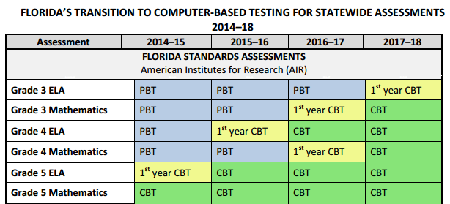
Transition to Computer Based Testing
Mathematics & ELA

Slide 5
Mathematics

Slide 6
New Standards for Mathematics
Mathematics Florida Standards (MAFS)
  http://www.cpalms.org/Standards/mafs.aspx
Breeze Presentation to describe changes in MAFS from Common Core State Standards
  https://connect.palmbeachschools.org/mafs_elementary/

Slide 7
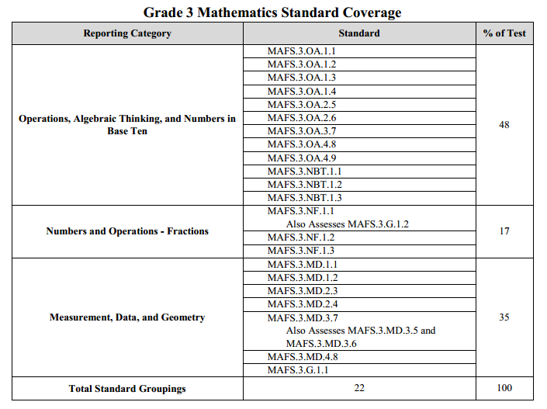
Test Design Summary – Grade 3

Slide 8
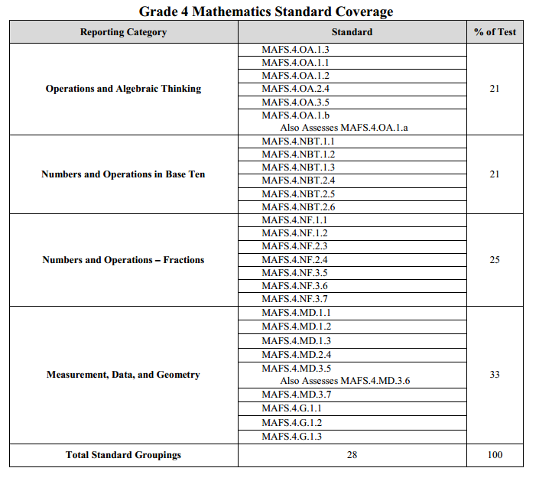
Test Design Summary – Grade 4

Slide 9
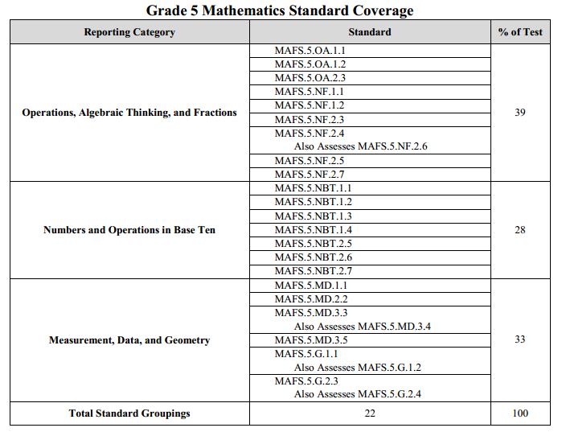
Test Design Summary – Grade 5

Slide 10
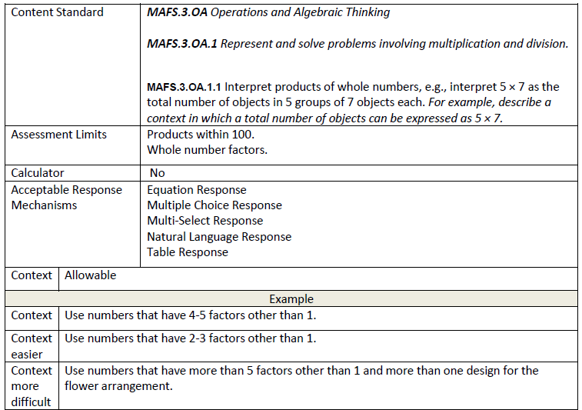
Test Item Specifications

Slide 11
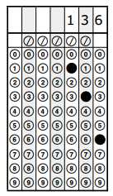
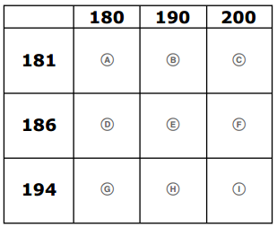
Important!
Grades 3-5 will use the following item types:
  Multiple Choice
  Equation Response
  Multiple Select
  Gridded Response
  Matching
Grade 5 will also use additional item types on the Computer-based test

Slide 12
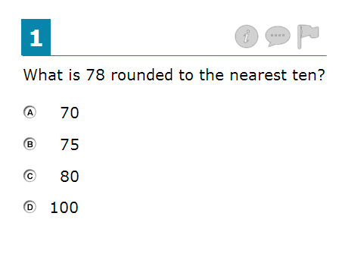
Item Types
Multiple Choice

Slide 13
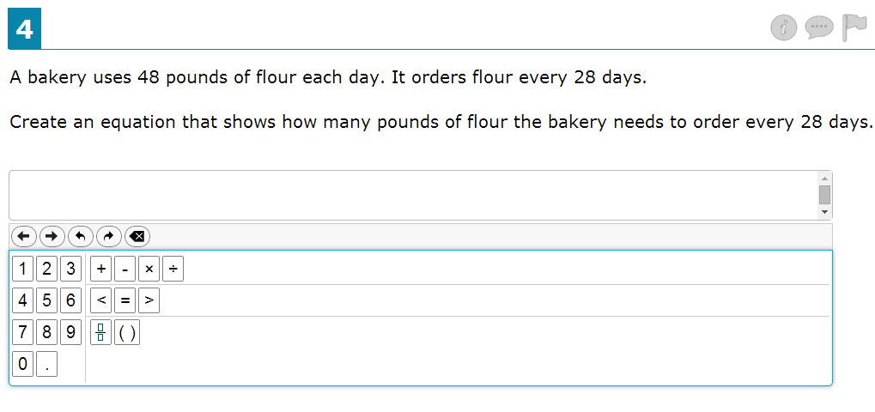
Item Types
Equation Response

Slide 14
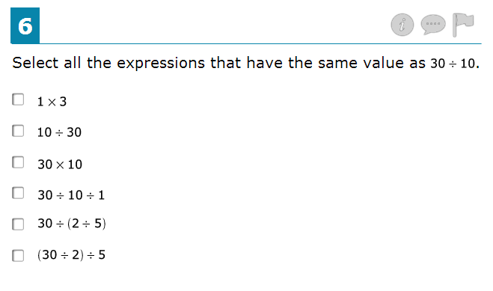
Item Types
Multiple Select Response

Slide 15
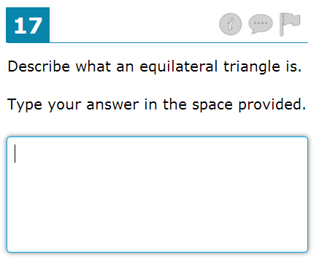
Item Types
Open Response (5th Grade Only)

Slide 16
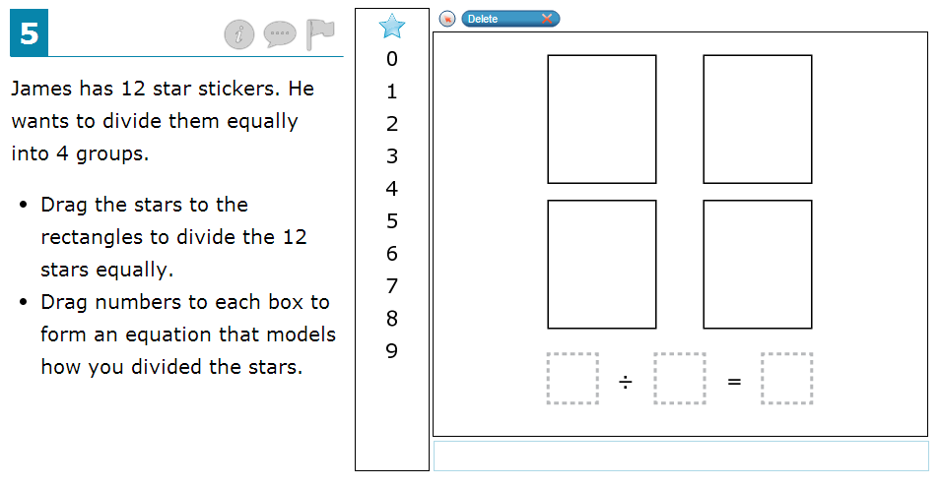
Item Types
Graphic Response Item Display – Drag and Drop (5th Grade Only)

Slide 17
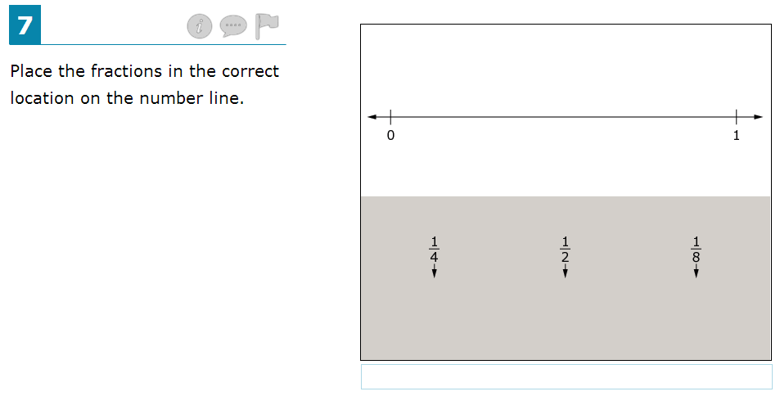
Item Types
Graphic Response – Hot Text (5th Grade Only)

Slide 18
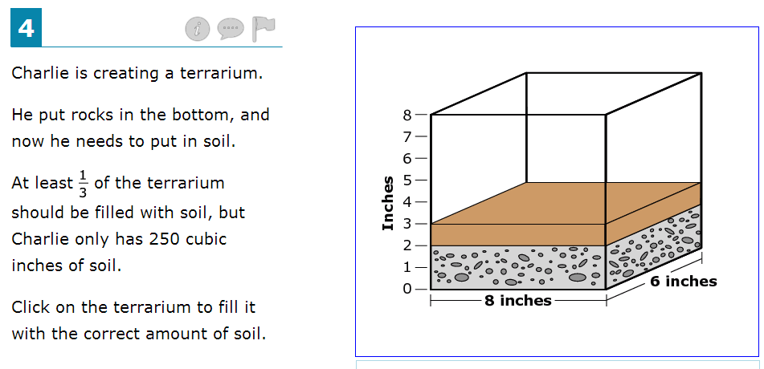
Item Types
Graphic Response – Hot Text (5th Grade Only)

Slide 19
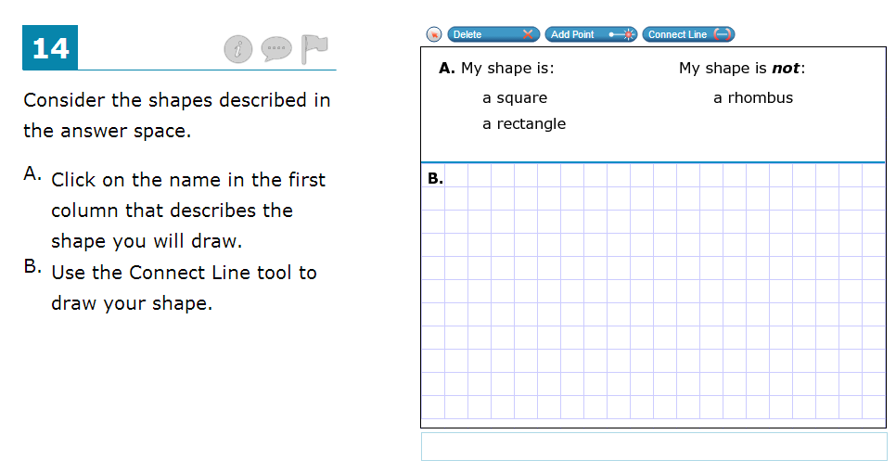
Item Types
Graphic Response Item Display – (5th Grade Only)

Slide 20
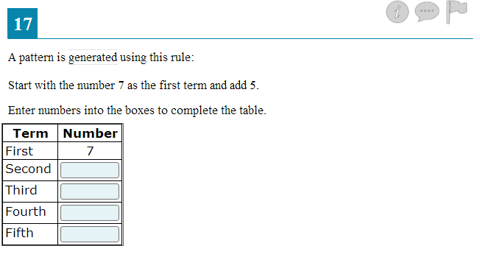
Item Types
Table Response

Slide 21
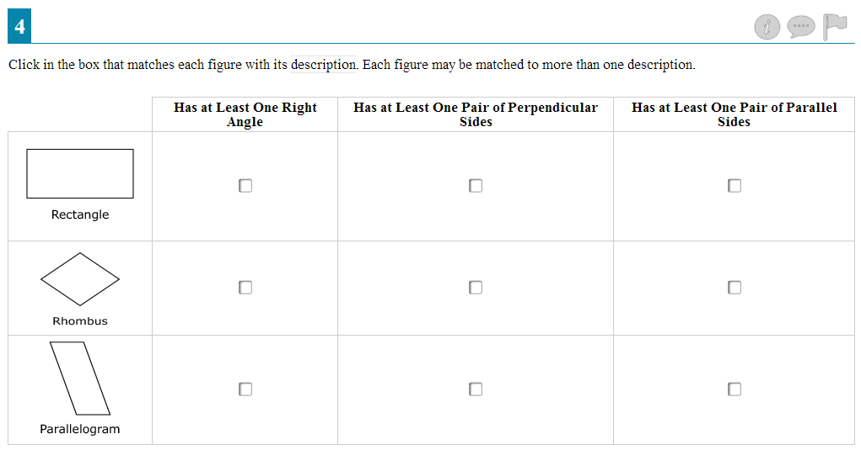
Item Types
Matching Item Response

Slide 22
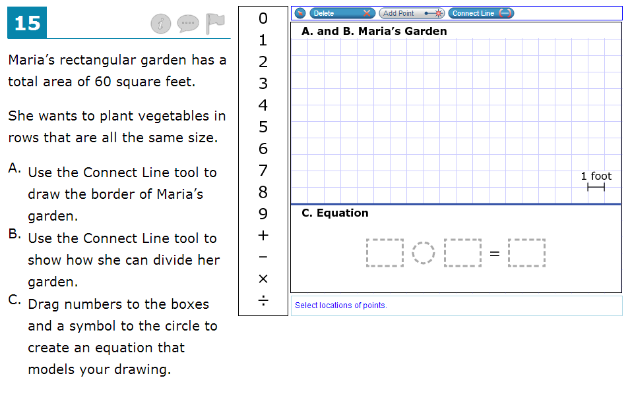
Item Types
More than one item type at a time (5th Grade Only)

Slide 23
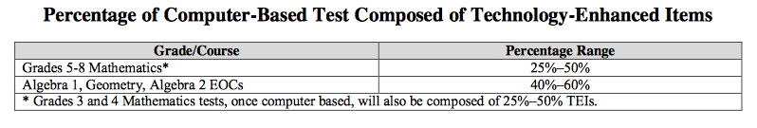
Technology Enhanced Items
New Draft of FSA Design Summary (Blueprint)

Slide 24
What is the District Doing to Support Teachers in Math?
Math Cadres
Unit Standards Assessments (USA’s)
Florida Standards Quizzes (FSQ’s)
Problems of the Day
Number Talks
Family Support Podcasts

Slide 25
Family Support
Breeze Presentation for Family support
  Posted on Edline and School District Website
  Will be created for each unit beginning in January
  Shows content and strategies for the unit
  Contains practice questions in FSA format

Slide 26


Slide 27
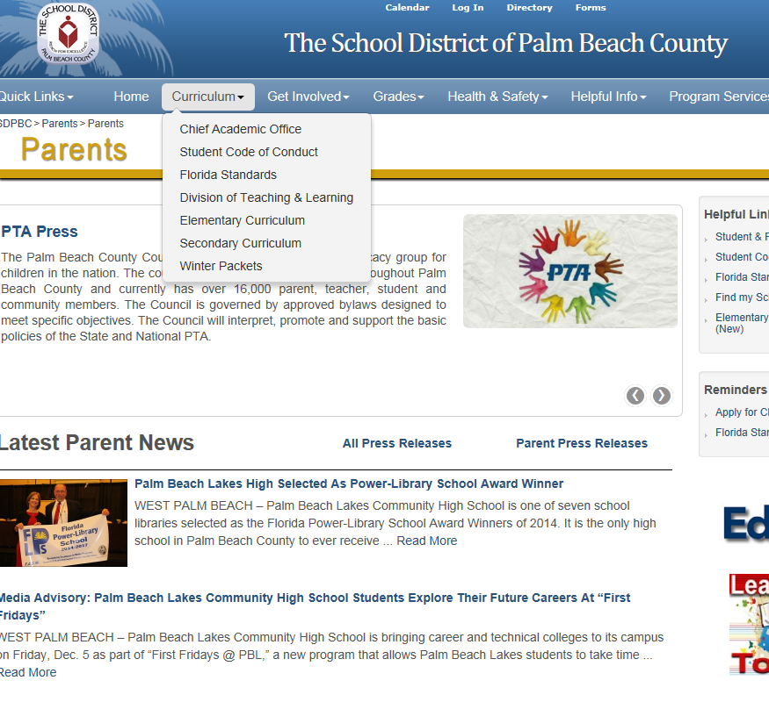

Slide 28


Slide 29
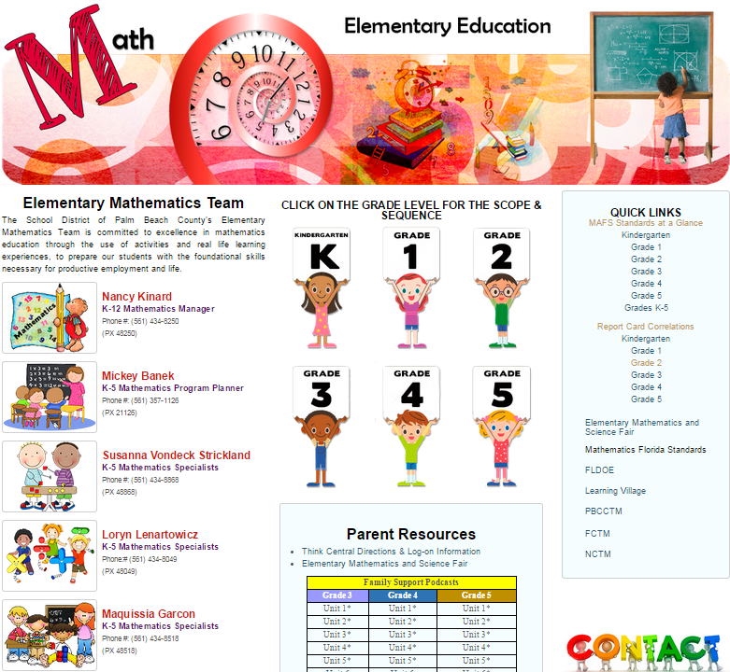

Slide 30
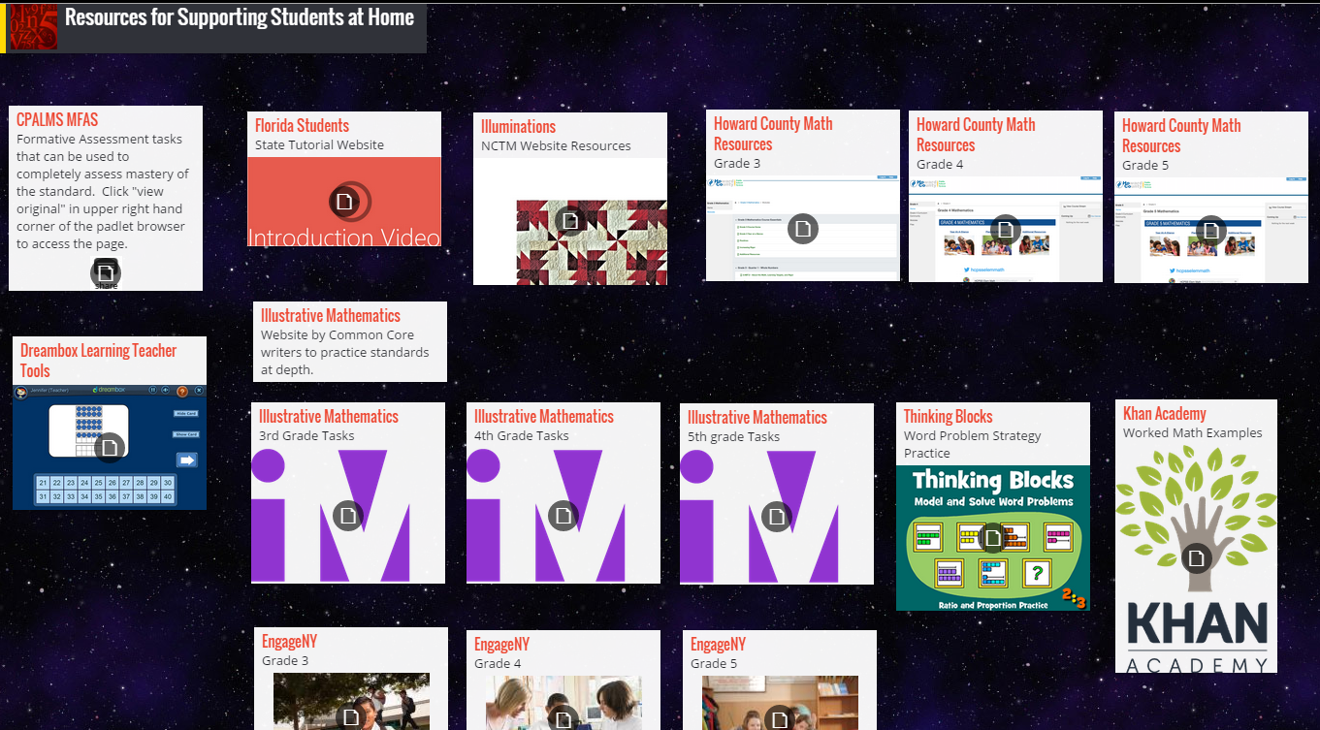
Useful Websites to Help your Children
http://padlet.com/mickey_banek/home_support

Slide 31
Tips for Helping your Child
Let your child try to complete their homework using the strategies they were taught in class.
Adopt a growth mindset: Everyone can be a “math person”.
Tell them that we can learn from our mistakes: They grow your brain.
Value learning: Some things may be difficult at first, but every day we make progress.
Value depth more than speed: Math is not a race, everyone needs time to make sense of math.
Ask them questions: Why does your answer make sense?
Learn with your child: You will find out why procedures and shortcuts work.

Slide 32
English Language Arts (ELA)
Reading and Writing Components

Slide 33
English Language Arts (ELA)
ELA Standards
Assessment Information
Test Item Specifications
Support for Schools

Slide 34
Standards for ELA
Language Arts Florida Standards (LAFS)
  http://www.cpalms.org/Public/search/standard#0

Slide 35
ELA Sessions and Times
FSA ELA Writing Component
Grade 4 | 120 Minutes | 1 Session
Grade 5 | 120 Minutes | 1 Session
FSA ELA Reading Component
Grade 3 | 160 Minutes | 2 Sessions (80 Minutes Each Session)
Grade 4 | 160 Minutes | 2 Sessions (80 Minutes Each Session)
Grade 5 | 160 Minutes | 2 Sessions (80 Minutes Each Session)
All sessions are administered over two days.

Slide 36
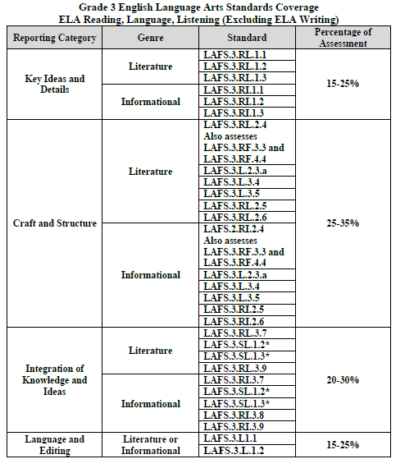
Test Design Summary – Grade 3

Slide 37
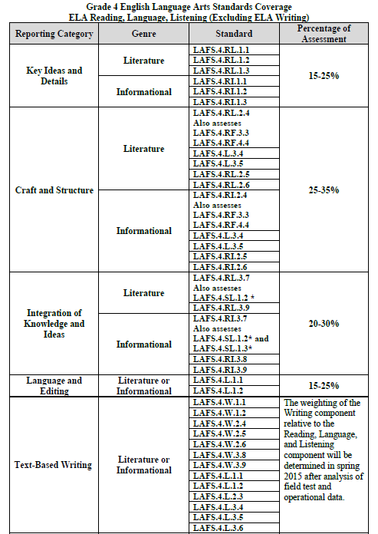
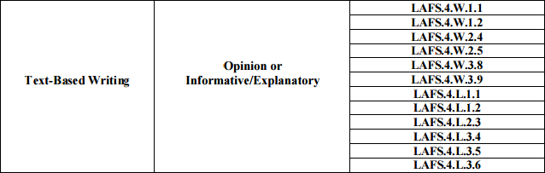
Test Design Summary – Grade 4

Slide 38
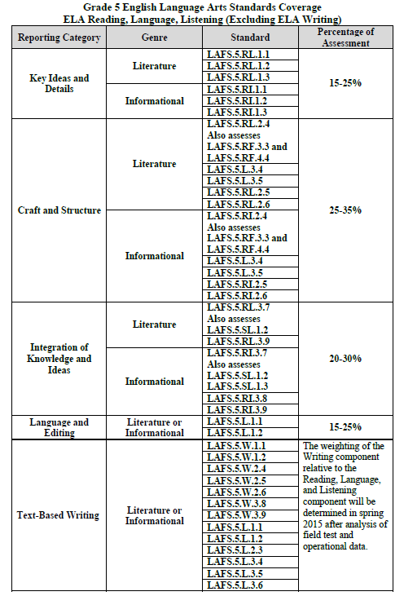
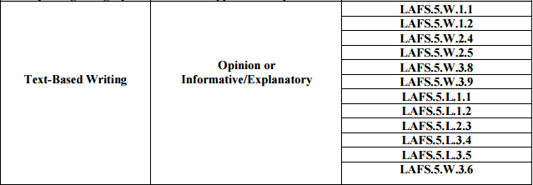
Test Design Summary – Grade 5

Slide 39
FSA-ELA Reading Component
Grades 3, 4, and 5
Number of Test Items: 56 – 60
Resources
Grades 3 and 4 (Paper-Based): Test and Answer Book
Grade 5 (Computer-Based): One-Page “Work Folder” for Note-taking
This is optional because students may also take notes using an on-screen notepad.
Word Count Range for a Text or Text Set
Grade 3 | 100 – 700
Grade 4 | 100 – 900
Grade 5 | 200 – 1000

Slide 40
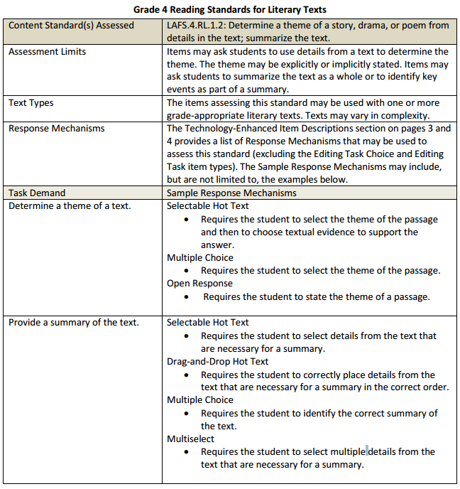
Test Item Specifications
ELA-Reading

Slide 41
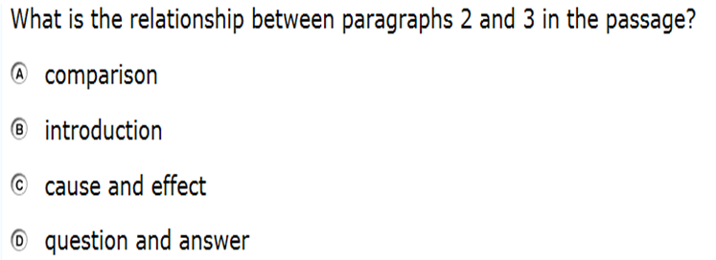
Item Type: Multiple Choice

Slide 42
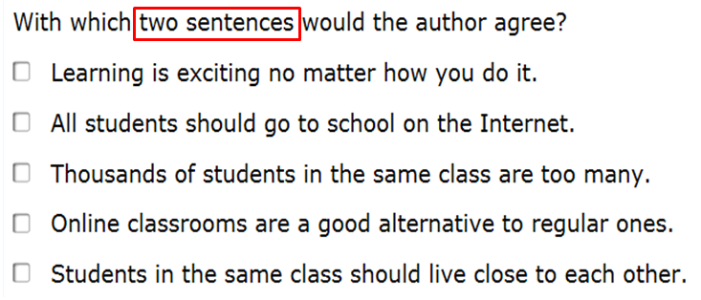
Item Type: Multiselect

Slide 43

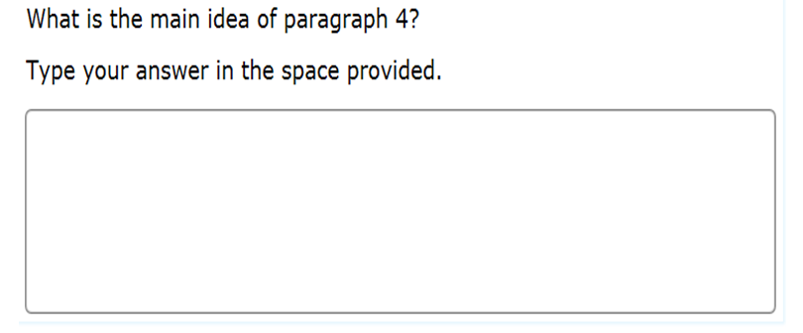
Item Type: Open Response

Slide 44
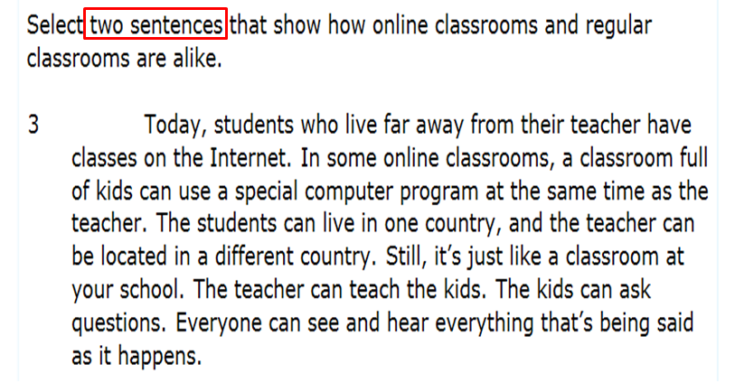
Item Type: Hot Text

Slide 45
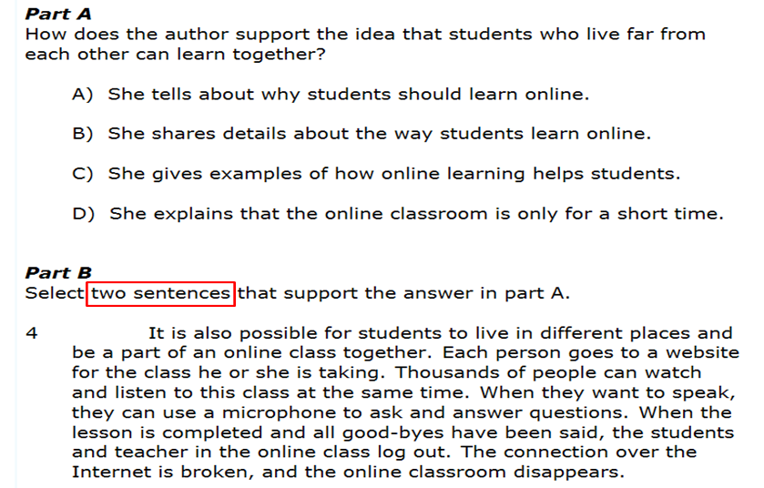

Item Type: Two Part-Hot Text

Slide 46
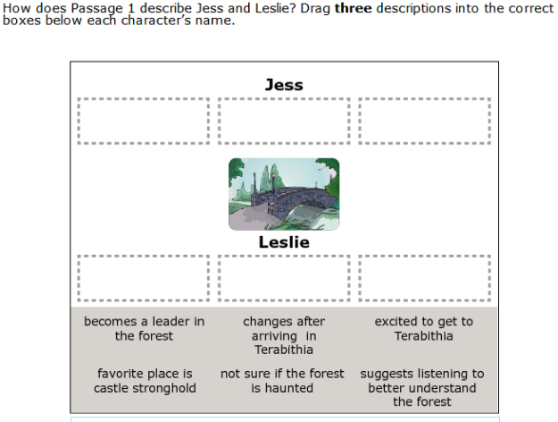
Item Type: Drag and Drop Hot Text

Slide 47
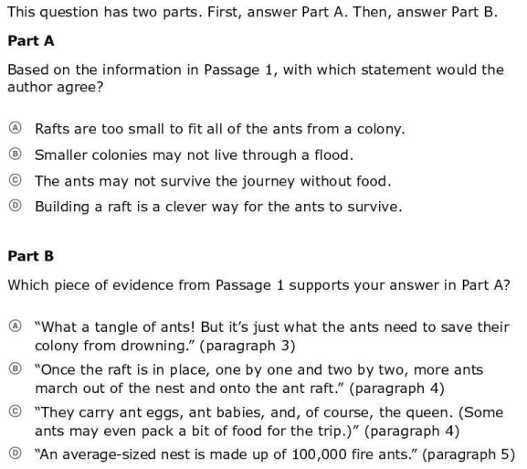
Item Type: Evidence-Based Selected Response

Slide 48
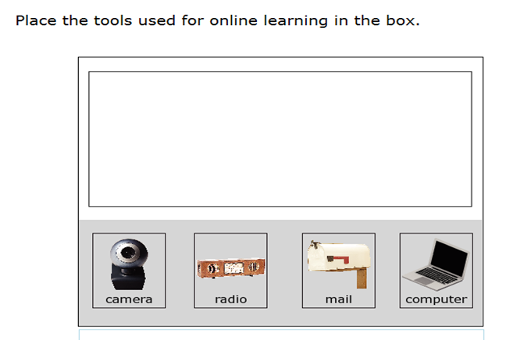
Item Type: Grid Item

Slide 49
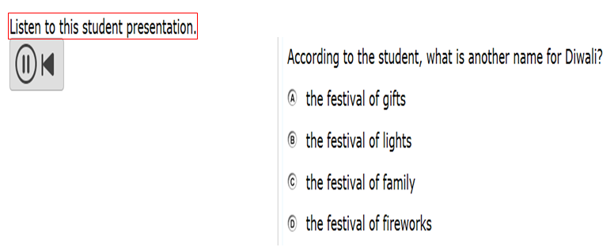
Item Type: Multimedia
(Grade 4 and 5 Only)

Slide 50

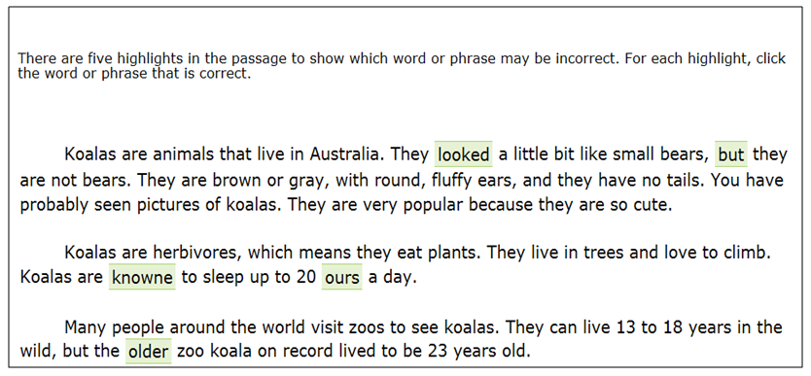
Editing Task
Word Count Range for Grades 3,4, and 5
100-200 Word Count

Slide 51
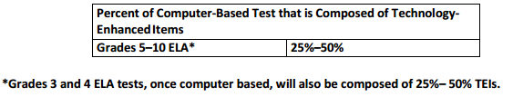
Technology-Enhanced Items
The Florida Standards Assessments (FSA) are composed of test items that include:
Traditional multiple-choice items
Items that require students to type or write a response
Technology-enhanced items (TEI) which are computer-delivered items that require students to interact with test content to select, construct, and/or support their answers.

Slide 52
FSA-ELA Writing Component
Grades 4 and 5
Word Count Range for
Text Sets (two-four texts on a single topic)
800 – 1300
Resources
Planning Sheet
Test and Answer Booklet

Slide 53

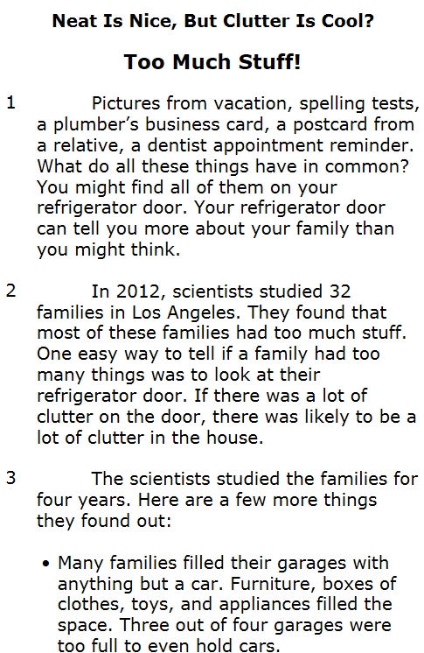
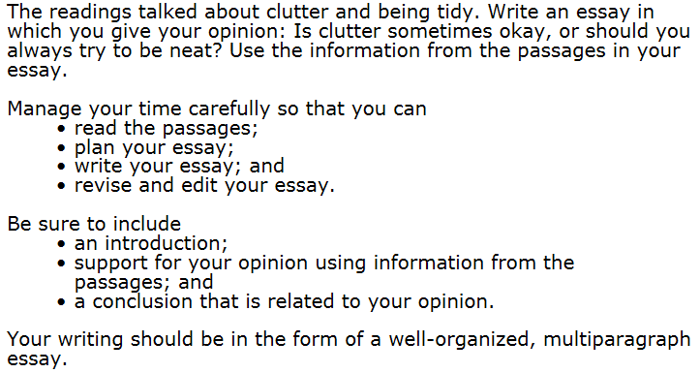
Text-Based Writing
Stimulus
Writing Prompt

Slide 54
What is the District Doing to Support Teachers?
Units of Study
Instructional Resources
Formative Assessments
School-based Common Planning
Writing Professional Development
School-based Support and Professional Development

Slide 55



Slide 56
Science
Science will continue to be assessed by the Statewide Science Assessment (formally known as the FCAT)
Testing window: April 13-May 8
Classroom Science instruction targets
Next Generation Sunshine State Standards (NGSSS)
Excellent Resources available on-line @ www.cpalms.org
Science Standards are packaged into “BIG IDEAS” of instruction according to grade level (next slide)

Slide 57
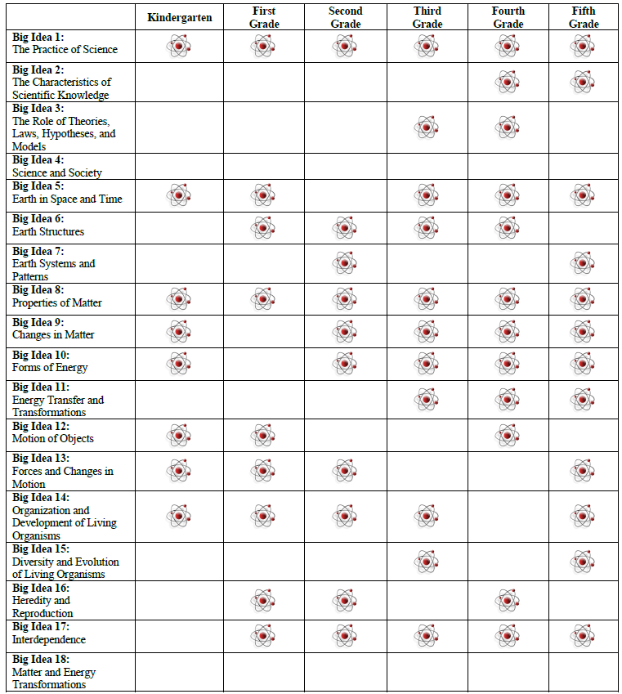
*An important note: Not all Big Ideas are taught each year so this requires mastery of science content within other grade levels of instruction.
We encourage parents to be aware of the expectations within science instruction and to work with their children to ensure their understanding of such concepts.

Slide 58
Additional Announcements
Research Ranger Program- A new science initiative for students/families of Palm Beach County- Students and families are encouraged to attend learning activities at various outdoor organizations and parks to become a certified “Field Research Ranger” (information Available on the PBC Parent pages for Science Curriculum).
Lesson Launchers- A new initiative encouraging teachers, students, and parents to get involved in making 3-5 minute video clips to share their knowledge of science (project based learning). This will become a collection of standards based videos created by our PBC learning community and utilized in classrooms to engage students in their science lessons/learning (Available through Vodcast/Blogs).

